Slide 1




Playwright
Integration with CI/CD - GitHub Actions

Slide 3

Introduction
Overview
Setting up GitHub Actions
On push/pull_request
Create a Repo and Push to GitHuB
YAML Configuration for Playwright Tests
Understanding the Workflow
Create tests in the local repo
Push code to GitHub
Opening the Workflows​
Viewing Test Logs​
HTML Report​
Downloading the HTML Report​
Viewing the HTML Report​
Summary
Overview

Slide 4
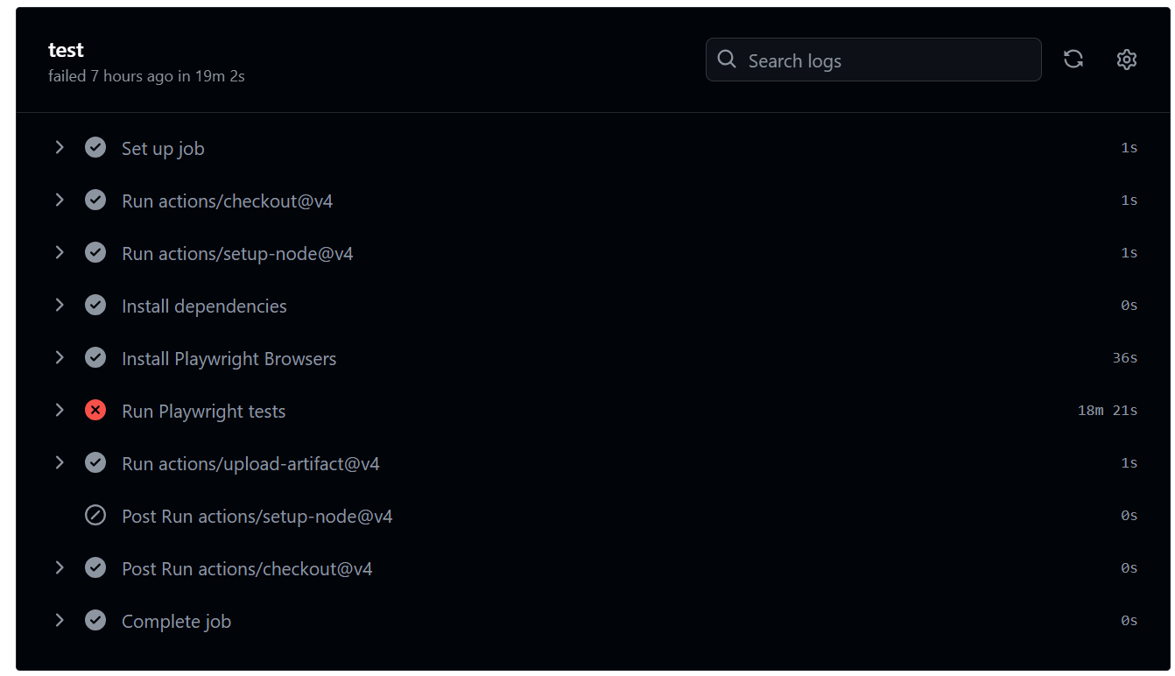

Slide 5
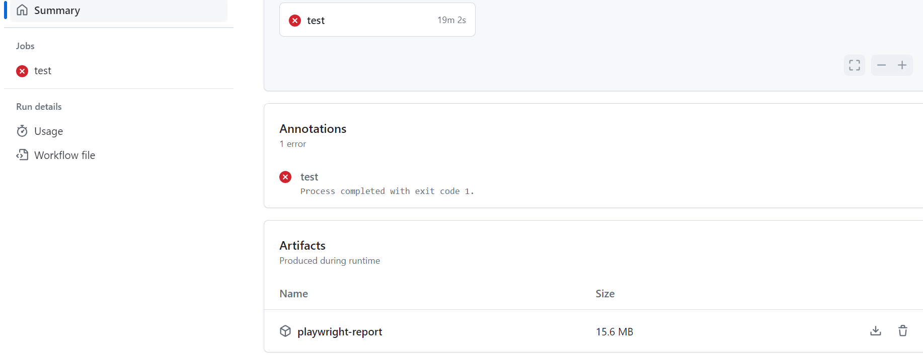

Slide 6
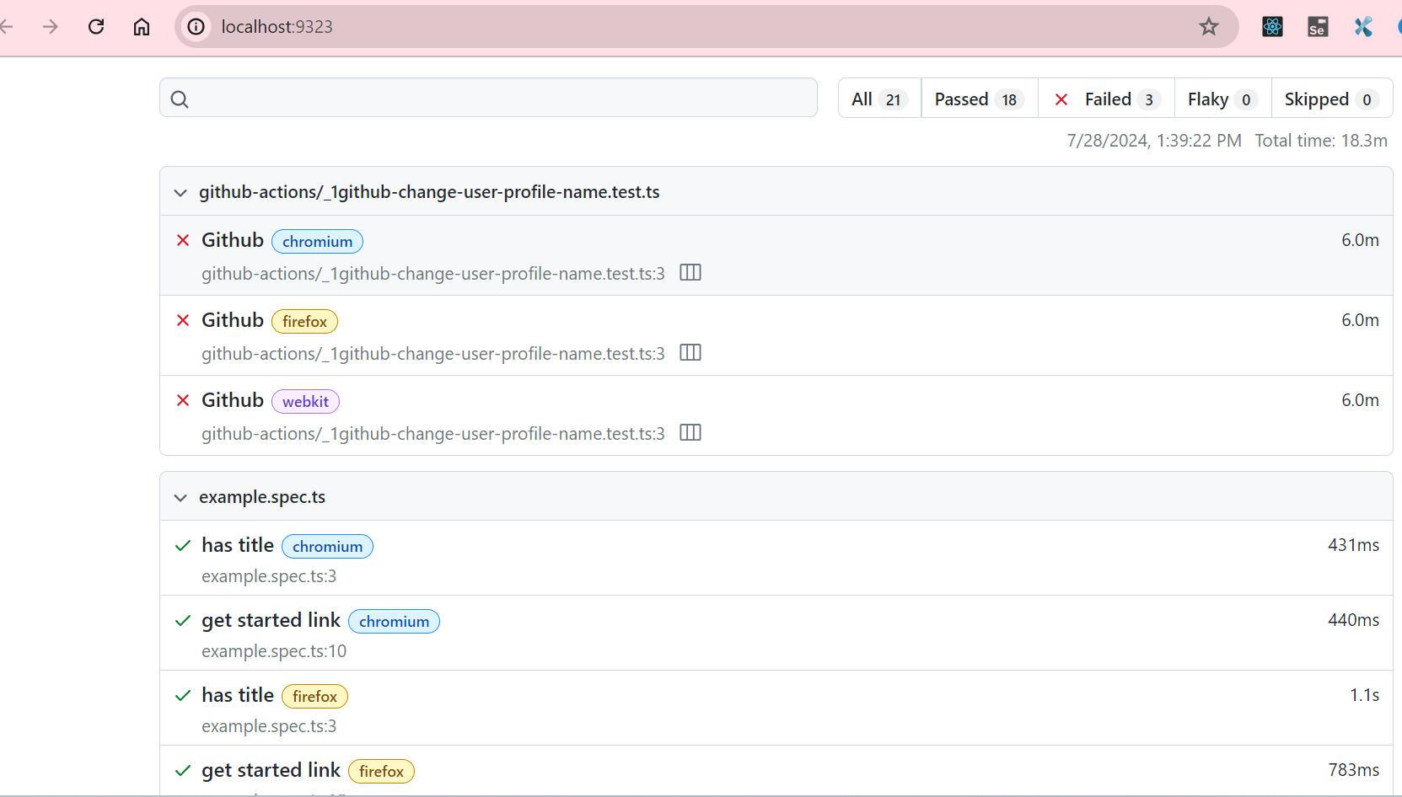

Slide 7
Benefits of Automation:-
•Increased Efficiency
•Faster Feedback Loop
•Consistency
Summary

Slide 8
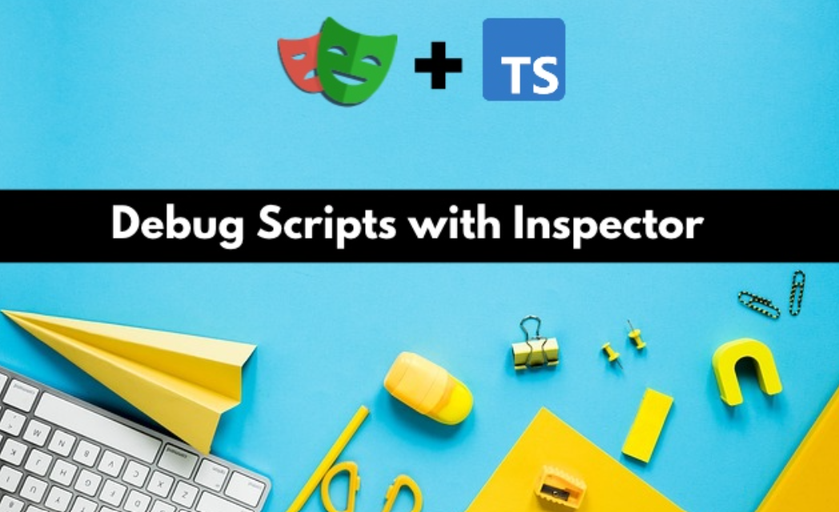

Slide 9
Debugging and Troubleshooting
Importance of Debugging
Overview
Common Challenges in Playwright
Element Not Found Issues
Page Navigation Issues
Authentication Issues
Debugging tests
Playwright Debugging using Visual Studio
Debug tests in UI mode
Debug tests with the Playwright Inspector​
Test reports​
Summary
Overview

Slide 10
Debugging helps to eliminate issues in the code.
It ensures that the code works seamlessly in the dynamic work environment where different issues like the element not found, page navigation issues or the authentication issues may pop-up.
Playwright provides multiple ways using which we can perform the debugging.
Right from using the Visual Studio Code debugging to Playwright Inspector, each of these ways offer a different view to the debugging option.
Summary

Slide 12
Introduction​
Testing philosophy​
Test user-visible behavior​
Make tests as isolated as possible​
Avoid testing third-party dependencies​
Testing with a database​
Best Practices

Slide 13
Best Practices
Use locators​
Use chaining and filtering​
Prefer user-facing attributes to XPath or CSS selectors​
Generate locators​
Use the VS Code extension to generate locators​
Use web first assertions​
Don't use manual assertions​
Best Practices

Slide 14
Configure debugging​
Local debugging​
Debugging on CI​
Use Playwright's Tooling​
Test across all browsers​
Keep your Playwright dependency up to date
​
Run tests on CI​
Lint your tests​
Use parallelism and sharding​
Productivity tips​
Use Soft assertions​
Best Practices

Slide 15
Handling Dynamic Elements
XPath
waitFor
all() method on a locator
Strategies to Avoid Writing Flaky Tests in Playwright
Implementing retries for failed tests.
Playwright documentation and API references
https://playwright.dev/docs/intro
https://playwright.dev/docs/api/class-playwright
Playwright Community
https://playwright.dev/community/welcome
Best Practices

Slide 16
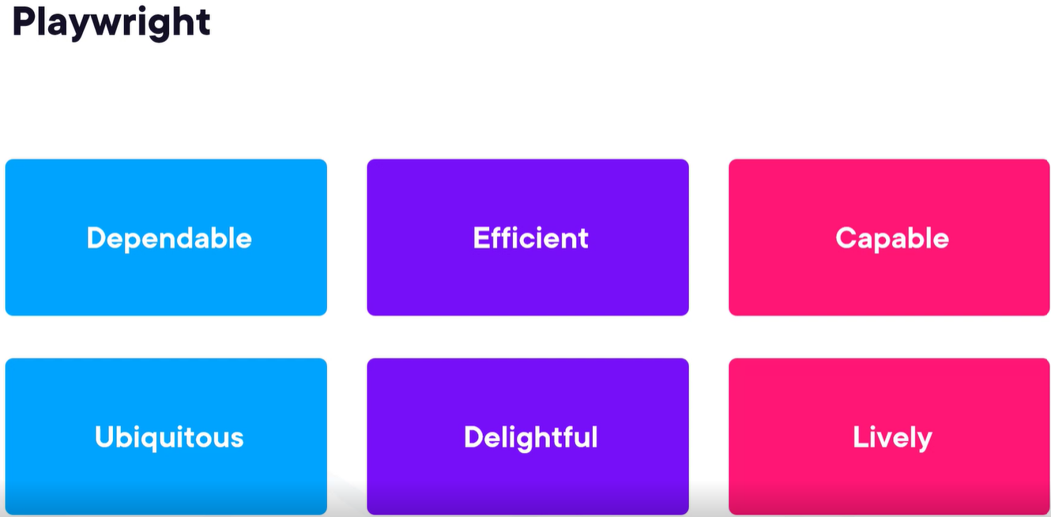
Summary

